Slide 1
CIS 4930-001: Introduction to Augmented and Virtual Reality
Human Perception

Slide 2
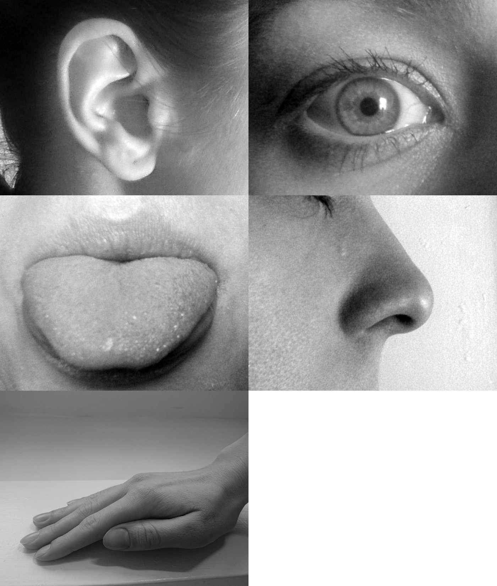
How do We Perceive Reality?
We understand the world through our senses:
Sight, Hearing, Touch, Taste, Smell (and others..)
Two basic processes:
Sensation – Gathering information
Perception – Interpreting information

Slide 3
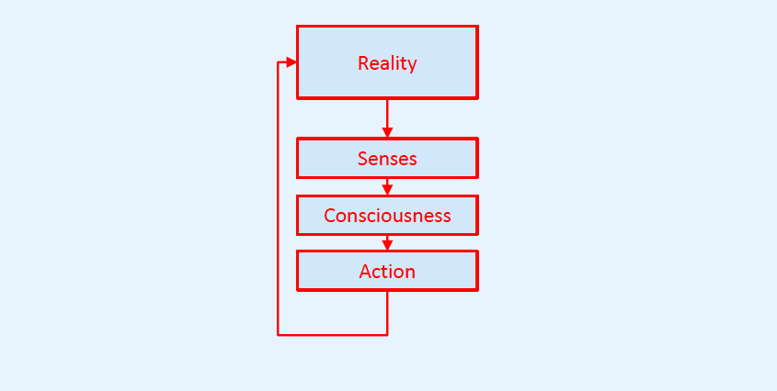
Simple Sensing/Perception Model

Slide 4
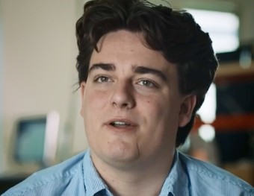
Goal of Virtual Reality
“.. to make it feel like you’re actually in a place that you are not.”
Palmer Luckey
Co-founder, Oculus

Slide 5
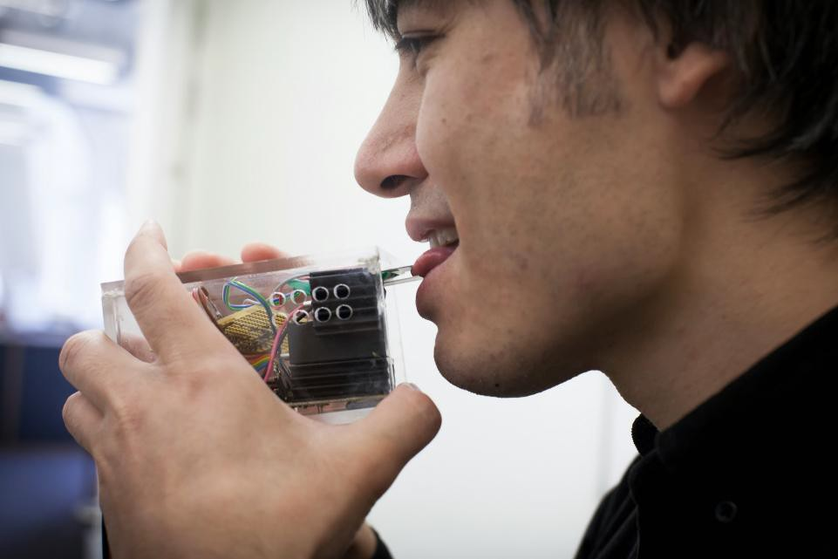
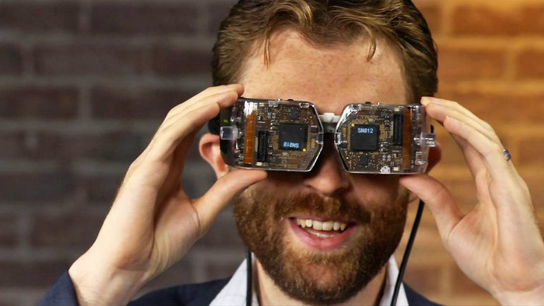
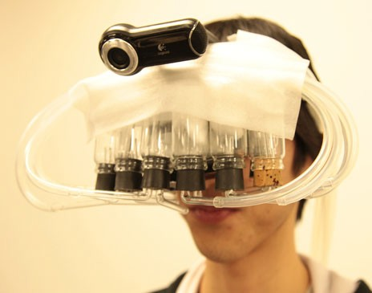
Creating the Illusion of Reality
Fooling human perception by using technology to generate artificial sensations
Computer generated sights, sounds, smell, etc.

Slide 6
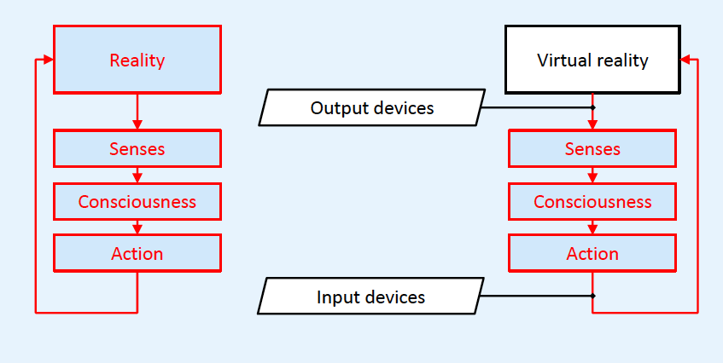
Reality vs. Virtual Reality
In a VR system there are input and output devices between human perception and action

Slide 7
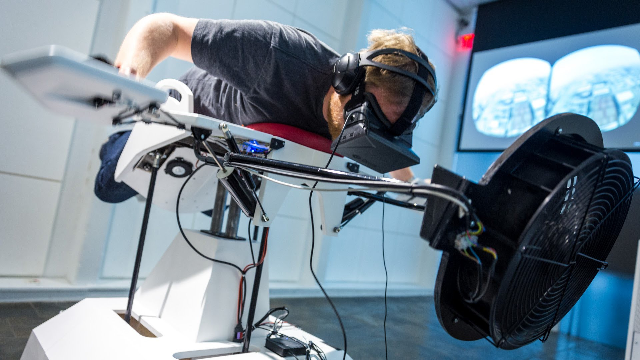
Example Birdly
Create illusion of flying like a bird
Multisensory VR experience
Visual, audio, wind, haptic
http://www.somniacs.co/

Slide 8
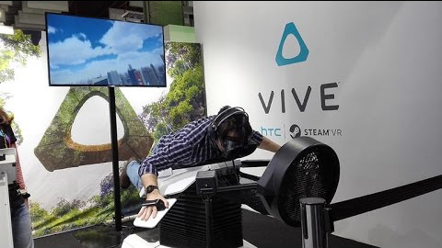
Birdly Demo
https://youtu.be/gHE6H62GHoM

Slide 9




Simulation
Understanding
Software
Hardware
Us

Slide 10
Visual Bandwidth
Bandwidth of vision is probably greater than other sensory modalities
Retina bandwidth ~10 Mbits/sec
Most important sense for VR?
IMAX movie of rollercoaster can induce sensation of motion
Images can induce sensations of taste/smell

Slide 11
Why Study Basis of Vision?
If a display can match human capabilities, we are done
If the display can’t, nice to know where to concentrate resources.

Slide 12
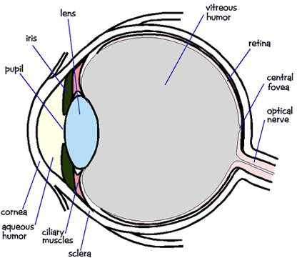
Anatomy of Vision

Slide 13
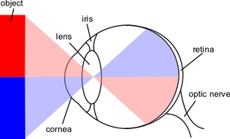
Eye Optics

Slide 14
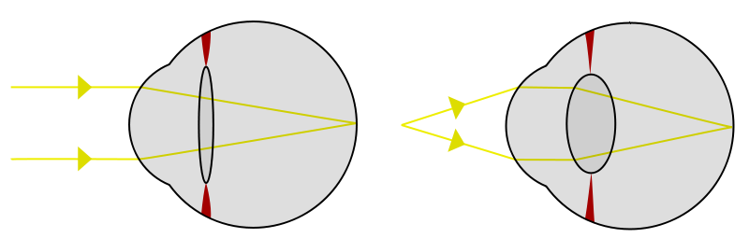
Accommodation
Change in curvature of lens
Rest focus from 6m to infinity

Slide 15
Visual Acuity
Cycles per degree (similar to angular resolution)
Humans can resolve 0.93mm spacing at 1m
Fovea is about 1 Mpixel
1 arc minute at fovea (1/60 degree)
20/20 vision letters are 5 arc minute letters (strokes 1 arc minute)
Around 24K x 24K over field of view
Retina is (dynamically) sensitive to light levels over 10^13 range

Slide 16
Psychophysics

Slide 17
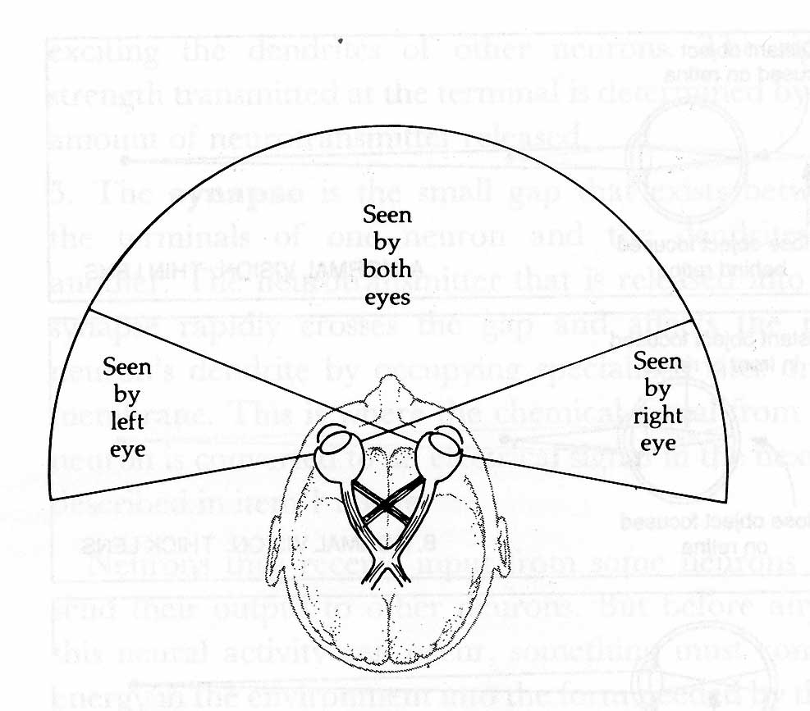
Visual Field
Monocular (one eye)
120° vertically and 150° horizontally
60° to nose; 90° to side
50° up; 70° down
Binocular (both eyes)
200° horizontal
Eye can rotate about 50°
Humans have 120° binocular overlap
2 x 40° monocular regions

Slide 18
Frame rate
60Hz frame rate is generally considered important
Old video games & movies at low rates but people weren’t sensitized to it

Slide 19
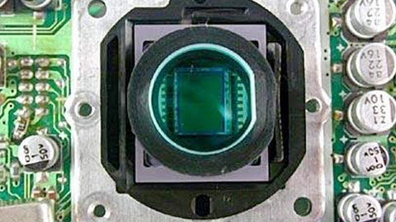
Frame rate
https://youtu.be/buSaywCF6E8

Slide 20
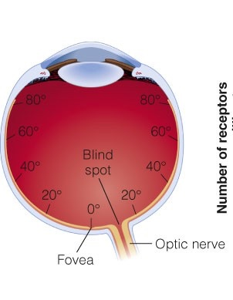
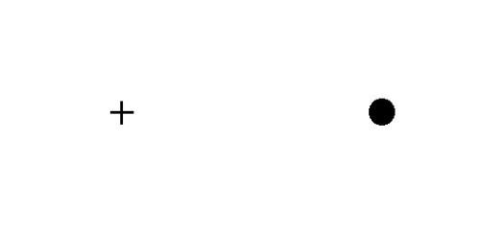
Blind Spot
Close left eye
Stair at +
Move forward and backward until disappears

Slide 21
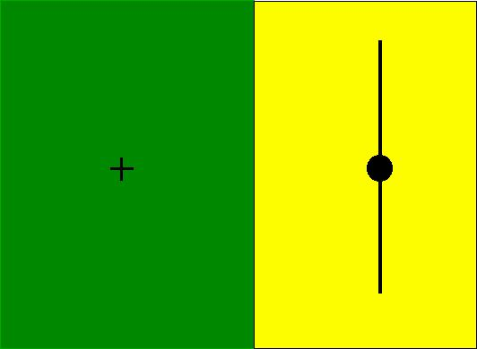
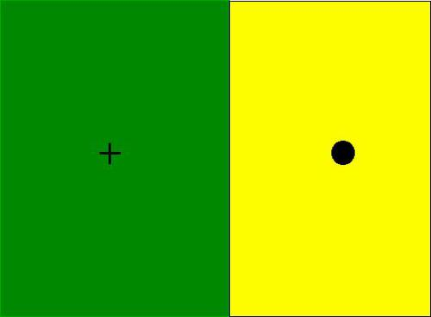
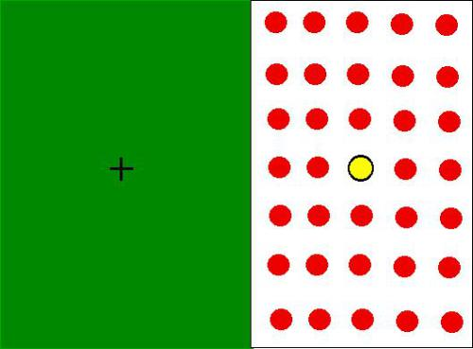
Blind Spot

Slide 22
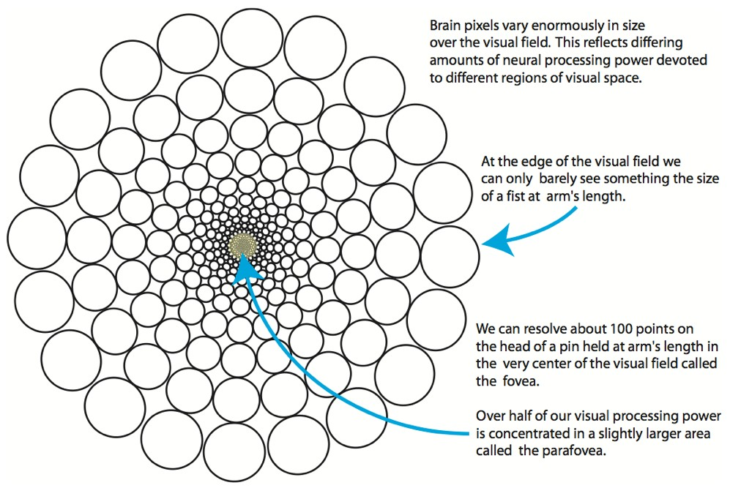
Ware 2010

Slide 23
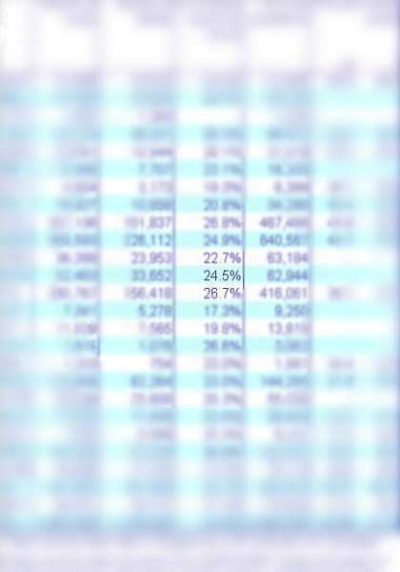
Foveation is relatively easy to see
The key to recognizing the phenomenon is to stair at a single word on the printed page.
Then, without moving your gaze, note the blurriness of the surrounding text.
C.Ware,“Visual Thinking for Design”

Slide 24
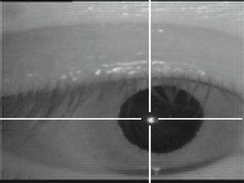
saccadic eye movements
rapid involuntary eye movements
moving: 20-100 ms
fixations: 200-600 ms
http://vision.arc.nasa.gov/personnel/jbm/home/projects/osa98/osa98.html

Slide 25
Other Eye Motion
Vergence - the motion of the eye to maintain binocular vision
‘Cross-eyed’ when focus in close
Version – eye movement in the same direction
Duction – motion of one eye
Eye makes compensatory motions when head moving
Shake hand vs. shake head
Saccades – eye movement to use fovea more
Microsaccades – imperceptible motions to maintain excitation of rods and cones

Slide 26
edge detection

Slide 27
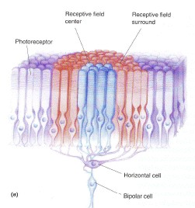
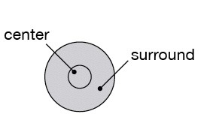

receptive field
light hits rods and cones
100M rods and cones
1M ganglion cells
single neuron fires
Bear, Connors, Paradiso, “Neuroscience”

Slide 28
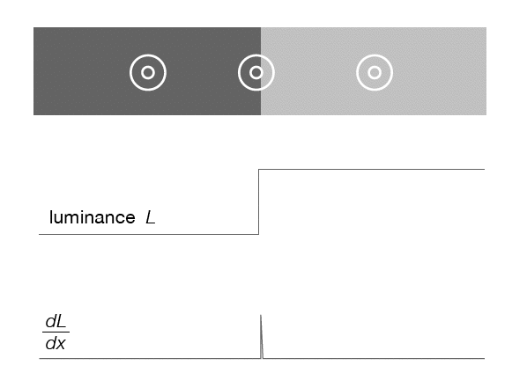
low activity
center and surrounds cancel
activity increased
or decreased at edges

Slide 29
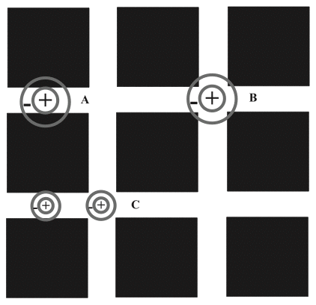
Hermann grid effect
Annie Prud’homme-Généreux

Slide 30
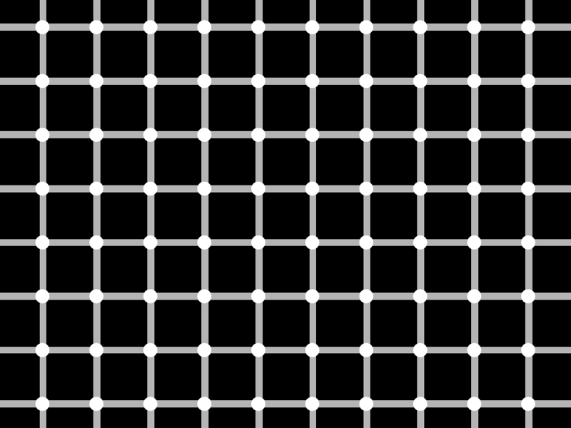

Slide 31
consequences of edge extraction

Slide 32
Cornsweet Illusion
Actual Luminance
Perceived Luminance

Slide 33
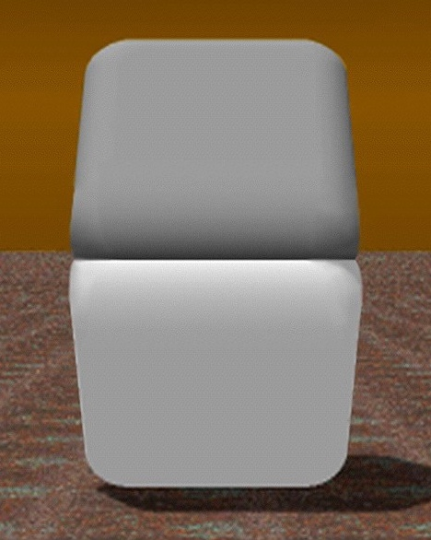
Cornsweet Illusion
D. Purves and R. B. Lotto

Slide 34

Mach Banding

Slide 35
simultaneous contrast

Slide 36
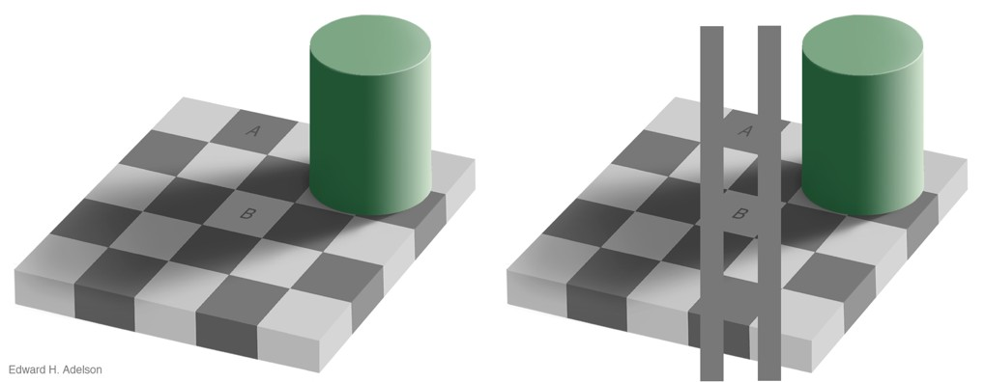
SIMULTANEOUS CONTRAST
http://persci.mit.edu/_media/gallery/checkershadow_double_full.jpg

Slide 37
SIMULTANEOUS CONTRAST

Slide 38
SIMULTANEOUS CONTRAST

Slide 39
SIMULTANEOUS CONTRAST

Slide 40
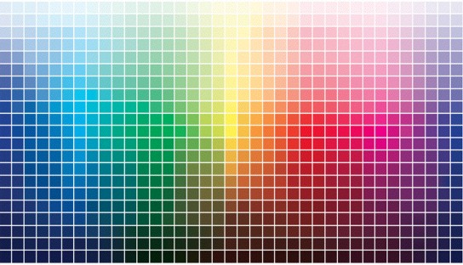
Color Perception

Slide 41
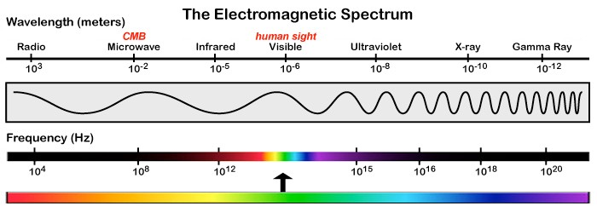
light

Slide 42
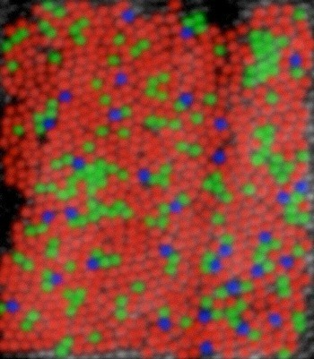
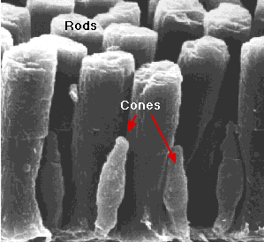
120 million rods
5-6 million cones
Wandell,“Foundations of Vision” (left) David R. Williams, Univ. of Rochester (right)

Slide 43
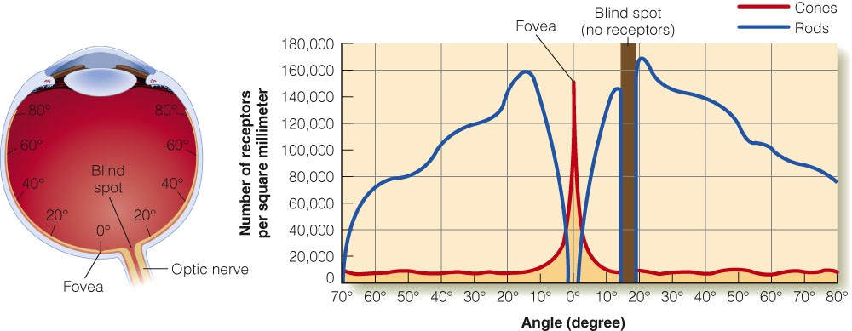
E. B. Goldstein “Sensation and Perception” (Adapted from Lindsay & Norman, 1977)

Slide 44
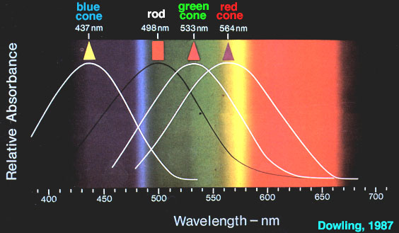
Cone Response

Slide 45
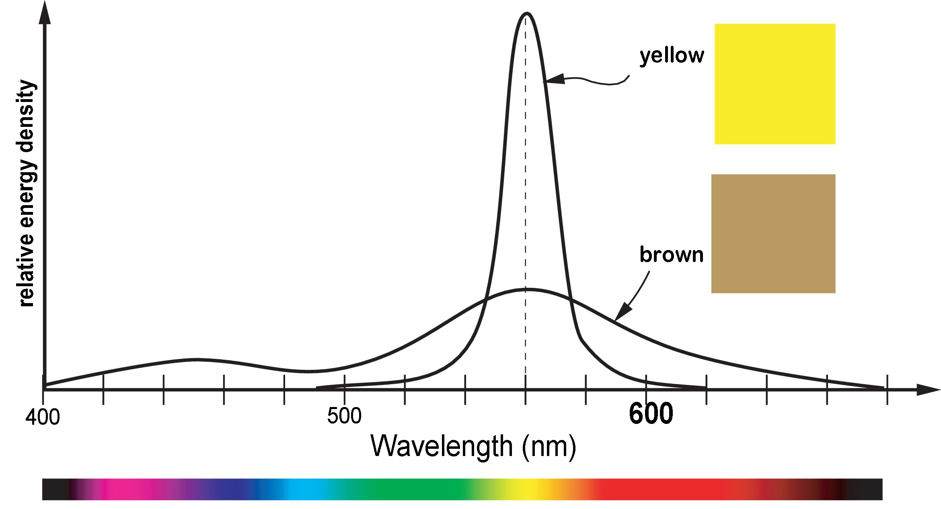
Color != Wavelength
but rather, a combination of wavelengths and energy

Slide 46
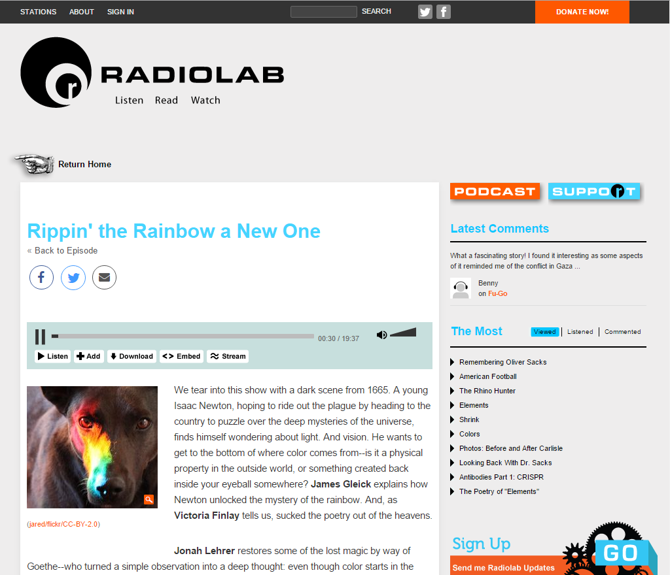
https://www.wnycstudios.org/story/211178-rip-rainbow

Slide 47
Color abstraction, representation

Slide 48
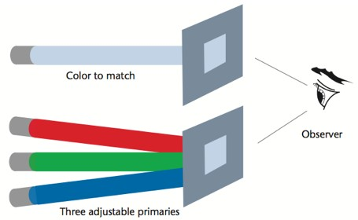
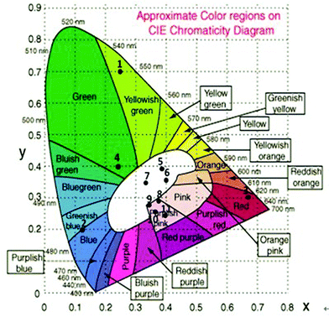
space of human color
CIE (International Commission on Illumination)
Standardized a set of color-matching functions that form the basis for most color measurement instruments
Experiments done in the 1920’s and 1930’s
Humans can mimic any pure (visible) light by addition and subtraction of three primary lights

Slide 49

ADDITIVE COLOR
(like we see in light)
primary: RGB
secondary: CMY

Slide 50
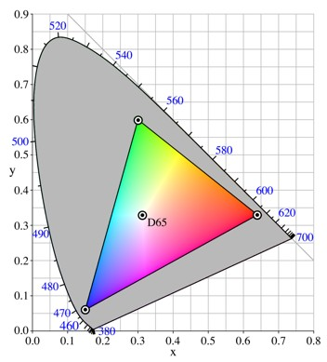
RGB color space
very common color space
not perceptually uniform
actual color is device-dependent
49

Slide 51
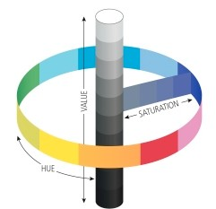
HSV [B, L, I] (additive)
Hue, Saturation, [Value, Brightness, Lightness, Intensity]
polar coordinate representations of RGB space
Conical or cylindrical shaped space
More intuitive than RGB for color tuning

Slide 52
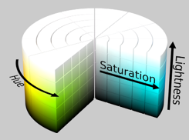
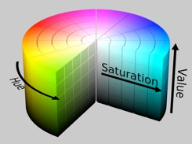
HSV [B, L, I] (additive)
hue: what people think of as color
saturation: amount of white mixed in
luminance: amount of black mixed in
lightness vs value (or brightness)
intensity, in computer vision applications

Slide 53

SUBTRACTIVE COLOR
(used in painting)
primary: RYB
secondary: OGV

Slide 54

SUBTRACTIVE COLOR
(used in print ink)
primary: CMY
secondary: RGB
approx black = C+M+Y
true black = C+M+Y+K
actual color is device-dependent

Slide 55
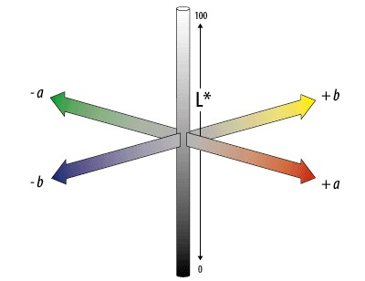
CIE LAB/LUV
mathematically defined & perceptually based to include all perceivable colors
a: red to green
b: yellow to blue
L*: lightness (black to white)

Slide 56
color deficiencies & limitations

Slide 57
COLOR BLINDNESS
Deficiency in color vision
Typically caused by faulty cone development
Found more in men than women
Photopigment genes carried in x-chromosome
5-8% of men and 0.5% of women

Slide 58
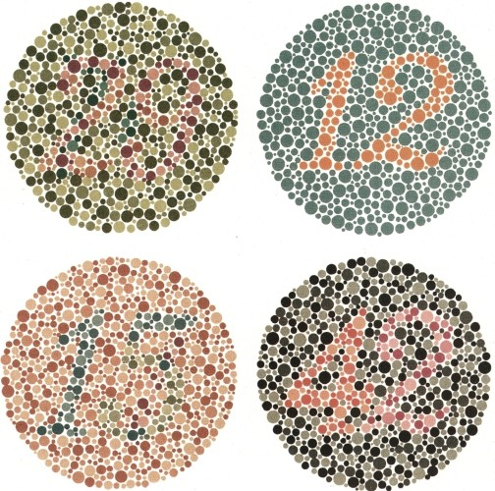

Slide 59
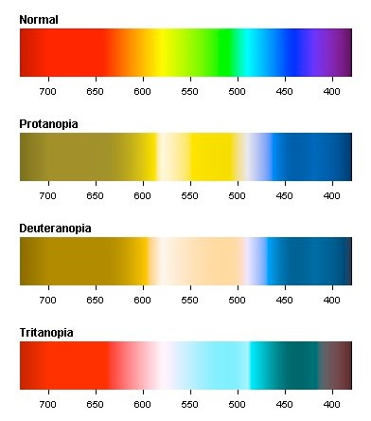
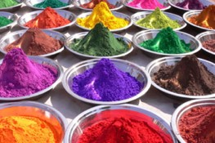
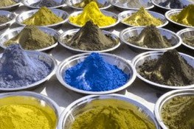
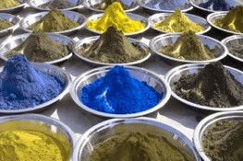


Slide 60
MONOCHROMACY
total color blindness, very rare
1 dimensional color vision
2 or 3 cone pigments are missing
rod monochromacy: non-functioning or missing cones (achromatopsia)
cone monochromacy: multiple deficient cones

Slide 61
DICHROMACY
2 dimensional color vision
1 cone pigment is missing
protanopia: absence of red receptors
deuteranopia: absence of green receptors
tritanopia: absence of blue receptors

Slide 62
TYPES: TRICHOMACY
3 dimensional color vision
1 cone is altered in spectral sensitivity—impairment rather than loss
protanomaly: shift in red, poor red-green discrimination
deuteranomaly: shift in green, poor red-green discrimination (most common form of color deficiency)
tritanomaly: poor blue-yellow discrimination

Slide 63
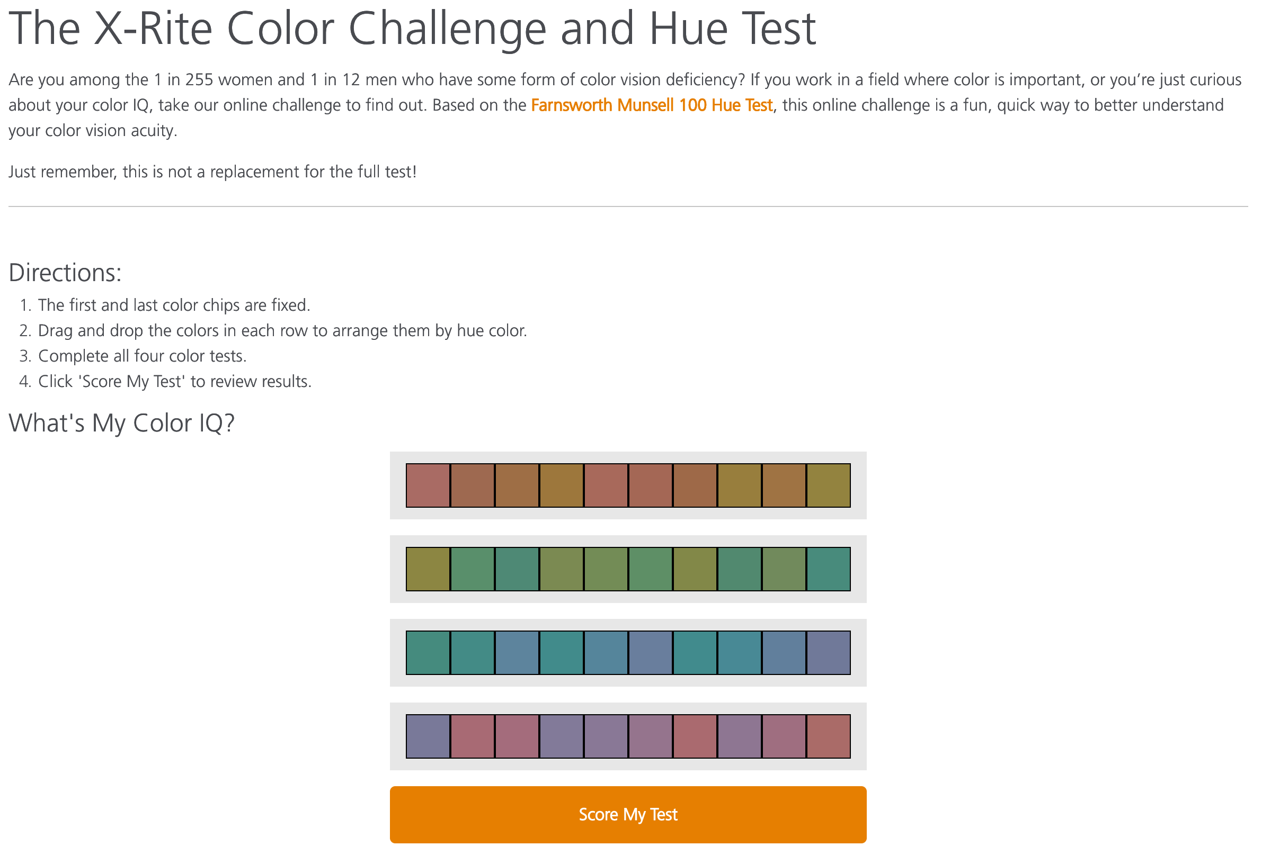
https://www.xrite.com/hue-test

Slide 64


Contrast Sensitivity
C.Ware, “Visual Thinking for Design”

Slide 65

Color Relativity

Slide 66
Color Relativity

Slide 67
Color Relativity

Slide 68

Color Relativity

Slide 69

Color Relativity

Slide 70


Color Relativity

Slide 71




SUCCESSIVE CONTRAST
look at a dot
then look at a dot

Slide 72


luminance contrast

Slide 73

EQUILUMINANT COLORS
strong contrast: shapes seen by color sensitive cells
equiluminance: hides positions from light sensitive cells
flickering/movement caused by this disconnect

Slide 74
Judgement & Perception

Slide 75
PRE-ATTENTIVE PROCESSING
requires attention, despite name
very fast: <200 ms
what matters most is contrast between features

Slide 76


Pick the outlier
Healy 2007

Slide 77


Pick the outlier
Healy 2007

Slide 78

CONJUNCTION
Healey 2007

Slide 79

BASIC POPOUT CHANNELS
Ware 2008

Slide 80

Gestalt principles
German: “Gestalt” = form
patterns transcend the visual stimuli that produced them

Slide 81

similarity
Bang Wong, “Gestalt Principles, 1”, Nature Methods

Slide 82



similarity
Andy Rutledge, “Gestalt Principles of Perception”

Slide 83




proximity
Andy Rutledge, “Gestalt Principles of Perception”

Slide 84

proximity
Bang Wong, “Gestalt Principles, 1”, Nature Methods

Slide 85

connectedness
Ware, “Information Visualization”

Slide 86

grouping
Similarity
Connection
Enclosure
Bang Wong, “Gestalt Principles, 1”, Nature Methods

Slide 87



grouping
proximity
similarity
enclosure
Jorge Camoes

Slide 88

continuity
Bang Wong, “Gestalt Principles, II”, Nature Methods

Slide 89

continuity
Bang Wong, “Gestalt Principles, II”, Nature Methods

Slide 90


closure

Slide 91


figure / ground

Slide 92
common fate
A. Rutledge

Slide 93
Gestalt principles
similarity: things that look like each other (size, color, shape) are related
proximity: things that are visually close to each other are related
connection: things that are visually connected are related
continuity: we complete hidden objects into simple, familiar shapes
closure: we see incomplete shapes as complete
figure / ground: elements are perceived as either figures or background
common fate: elements with the same moving direction are perceived as a unit

Slide 94
AXIS OF ALIGNMENT

Slide 95
AXIS OF ALIGNMENT

Slide 96

Attention
https://youtu.be/vJG698U2Mvo

Slide 97

Vection
Illusions of movement—motions in the display give the viewer a sensation that they have moved.
https://youtu.be/61YMtx7Ofec

Slide 98

Vestibulo-Ocular Reflex
Reflex, where activation of the vestibular system of the inner ear causes eye movement
https://youtu.be/mlbyNq8KedQ

Slide 99








More Optical Illusions
• •
• •
•
• •
•
•
. '·.
• • •
•
• •
•
•
•
•
•
•
•
•
·,.₋.
•
••
•
•
•
.·. >
.'
..·. '•. :..
'
• •
. .
'
. .
•
•
• • •
•
'
•
•
• •
'.
•
•
•
•
•

Slide 100
Depth Perception
More on this later

Slide 101
Other Processes

Slide 102
Problems
Mismatching Sensory information
For example: Vision and acceleration is not matched in a flight-simulator. (Unless an advanced motion-platform is used).
Update frequency
Due to simulation, scene complexity, etc.
Frame rate (FPS), the rate of which the system can generate new images

Slide 103
Problems
Latency
Due to simulation, graphic rendering of scene, device updates, etc. a latency is introduced.
The time it takes for the system to react onto a users action
Using an HMD
Eye convergence, fix focus
Simulator sickness (Cyber sickness) could be the result

